Slide 1
Deep Image Prior
Dmitry Ulyanov, Andrea Vedaldi, Victor Lempitsky
Partial content of this slide refers the presentation given by Dmitry Ulyanov regarding to the paper

Slide 2
Background and Motivation
State-of-the-art ConvNets for image restoration and generation are almost invariably trained on large datasets of images. One may thus assume that their excellent performance is due to their ability to learn realistic image priors from a large number of example images.
However, learning alone is insufficient to explain the good performance of deep networks.
Recent research has shown that generalization requires the structure of the network to “resonate” with the structure of the data.

Slide 3
What did they do?
In this paper, they show that, contrary to the belief that learning is necessary for building good image priors, a great deal of image statistics are captured by the structure of a convolutional image generator independent of learning.
They cast reconstruction as a conditional image generation problem and show that the only information required to solve it is contained in the single degraded input image and the handcrafted structure of the network used for reconstruction.
Instead of trying to beat the state-of-art neural networks, they try to show the structure of the network imposes strong prior.

Slide 4
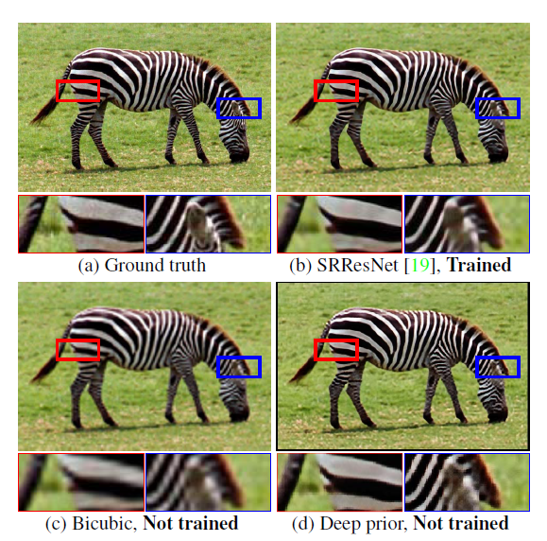
Result

Slide 5
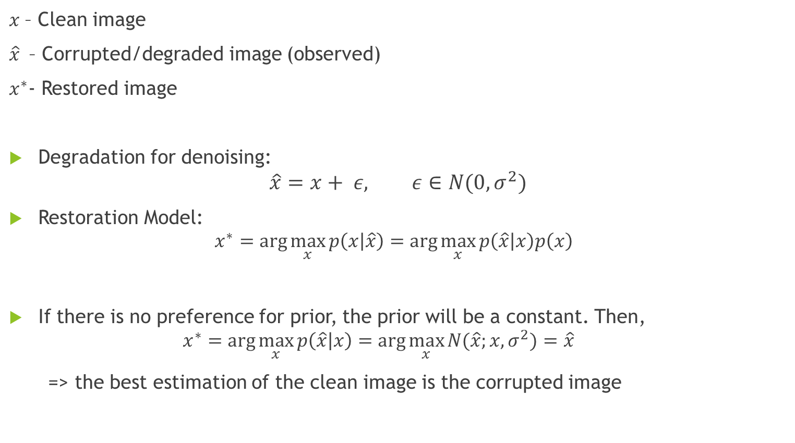
Image restoration - Method
$x$– Clean image
$\hat{x}$ – Corrupted/degraded image (observed)
$x^{∗}$- Restored image
Degradation for denoising:
$$\hat{x}=x+ ε, ε∈N(0, σ^{2})$$
Restoration Model:
$$x^{∗}=\arg{\max_{x}{p\left(x | \hat{x}\right)=\arg{\max_{x}{p\left(\hat{x} | x\right)p\left(x\right) }}}}$$
If there is no preference for prior, the prior will be a constant. Then,
  $$x^{∗}=\arg{\max_{x}{p\left(\hat{x} | x\right)=\arg{\max_{x}{N(\hat{x};x,σ^{2})}}}}=\hat{x}$$
  => the best estimation of the clean image is the corrupted image
likelihood prior

Slide 6
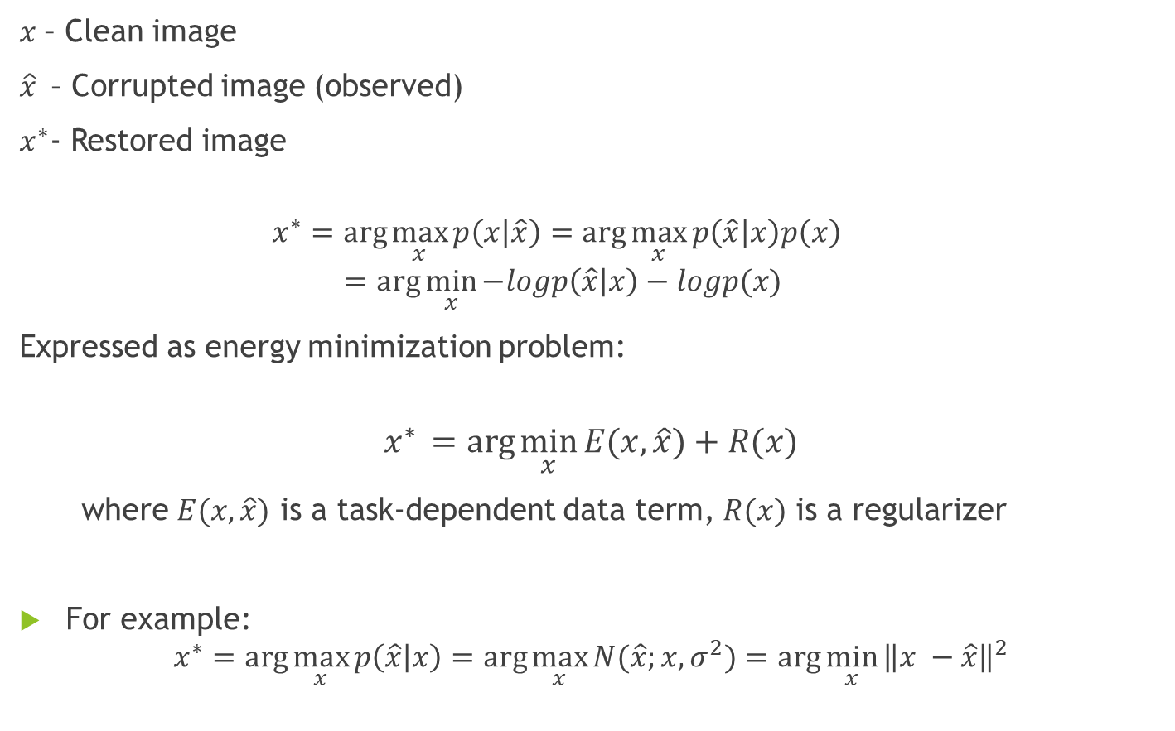
$x$– Clean image
$\hat{x}$ – Corrupted image (observed)
$x^{∗}$- Restored image
  $$x^{∗}=\arg{\max_{x}{p\left(x | \hat{x}\right)=\arg{\max_{x}{p\left(\hat{x} | x\right)p\left(x\right) }}}}$$
  $$=\arg{\min_{x}{−logp\left(\hat{x} | x\right)−logp(x)}}$$
  Expressed as energy minimization problem:
$$x^{∗} =arg{\min_{x}{E(x,\hat{x})+R(x)}}$$
where $E(x,\hat{x})$ is a task-dependent data term, $R(x)$ is a regularizer
For example:
$$x^{∗}=\arg{\max_{x}{p\left(\hat{x} | x\right)=\arg{\max_{x}{N(\hat{x};x,σ^{2})}}}=\arg{\min_{x}}{\left\|x −\hat{x}\right\|}^{2}}$$

Slide 7
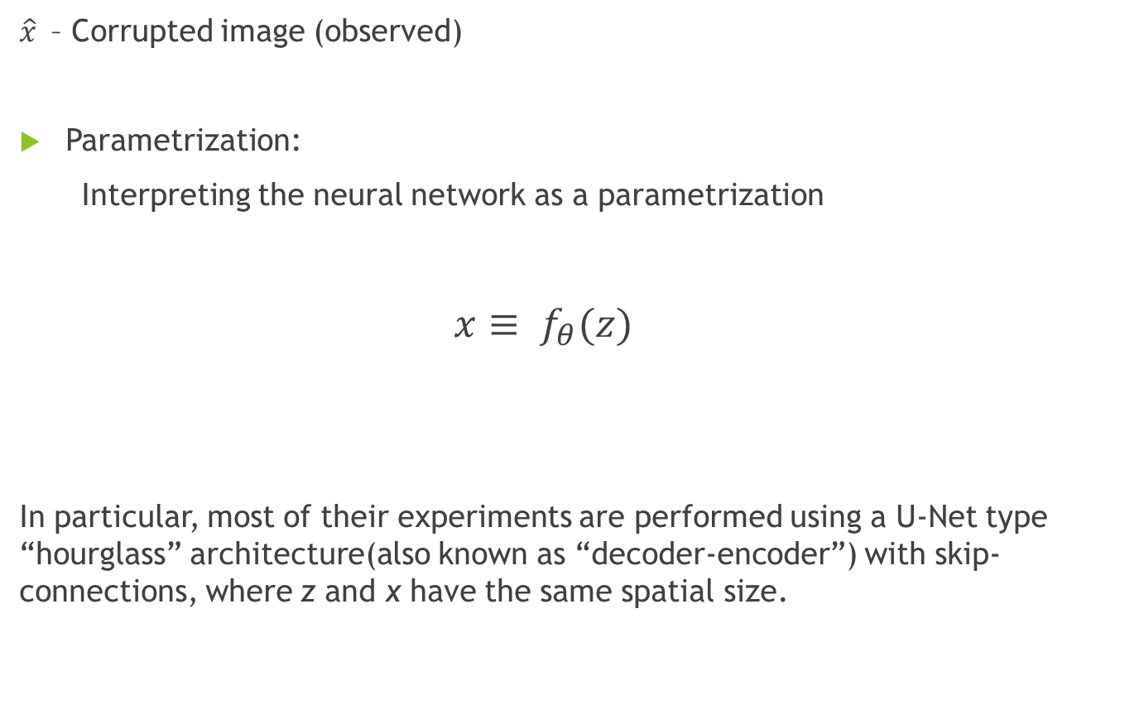
Deep Image Prior
$\hat{x}$ – Corrupted image (observed)
Parametrization:
Interpreting the neural network as a parametrization
$x≡ f_{θ}(z)$
In particular, most of their experiments are performed using a U-Net type “hourglass” architecture(also known as “decoder-encoder”) with skip-connections, where z and x have the same spatial size.
Fixed input z
Convolutional network with parameter θ

Slide 8
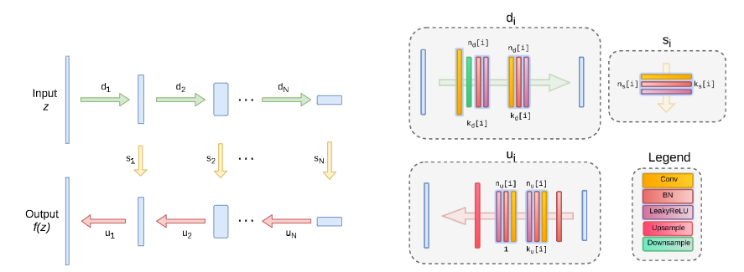
Architecture used in the experiments

Slide 9
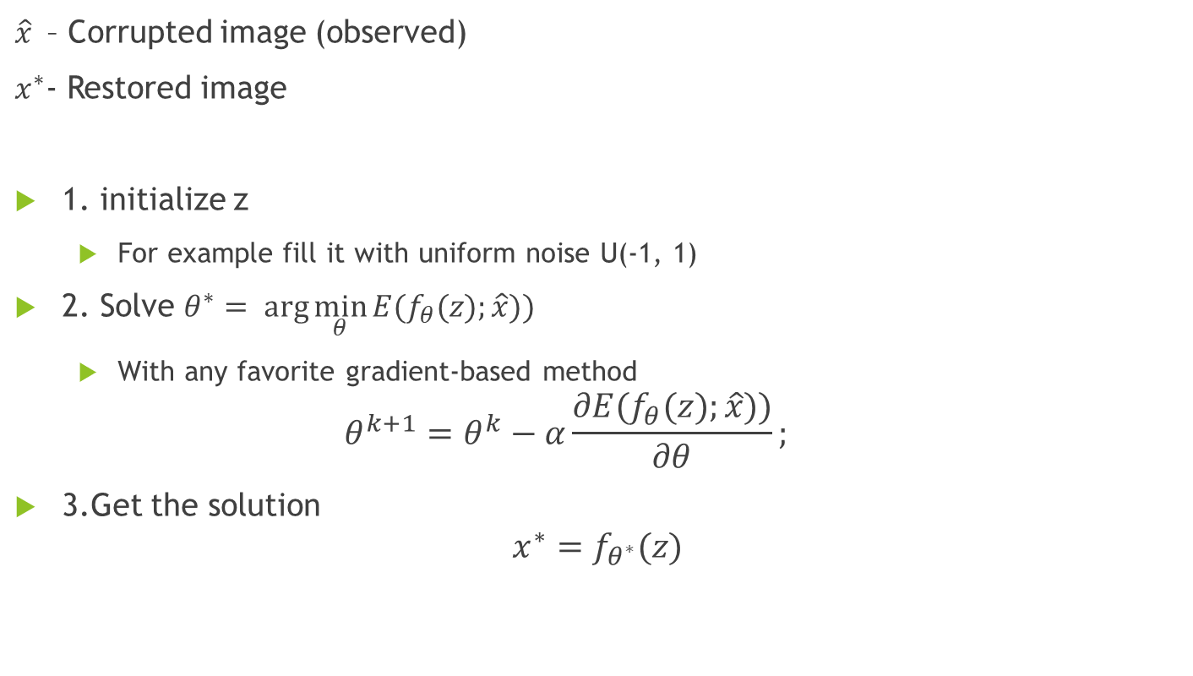
Deep Image Prior step by step
$\hat{x}$ – Corrupted image (observed)
$x^{∗}$- Restored image
1. initialize z
  For example fill it with uniform noise U(-1, 1)
2. Solve $θ^{∗}= arg{\min_{θ}{E(f_{θ}(z);\hat{x}))}}$
  With any favorite gradient-based method
  $$θ^{k+1}=θ^{k}−α\frac{∂E(f_{θ}(z);\hat{x}))}{∂θ};$$
3.Get the solution
$$x^{∗}=f_{θ^{∗}}(z)$$

Slide 10
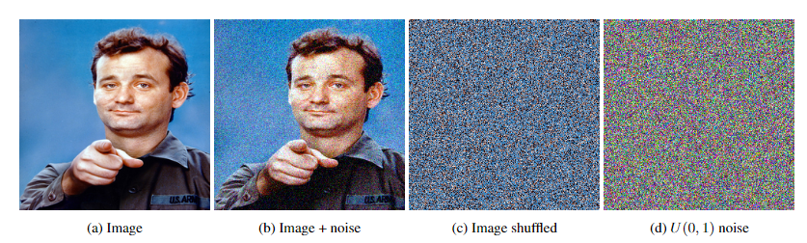
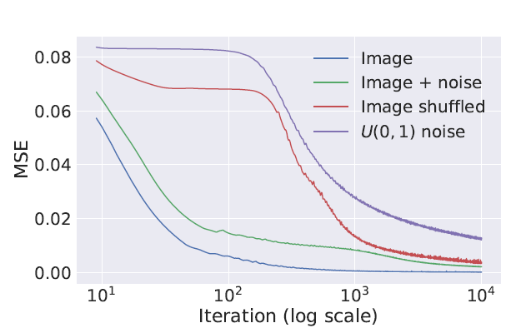
The network has high impedance to noise and low impedance to signal.
Therefore for most applications,
They restrict the number of iterations in the optimization process to a certain number of iterations.

Slide 11
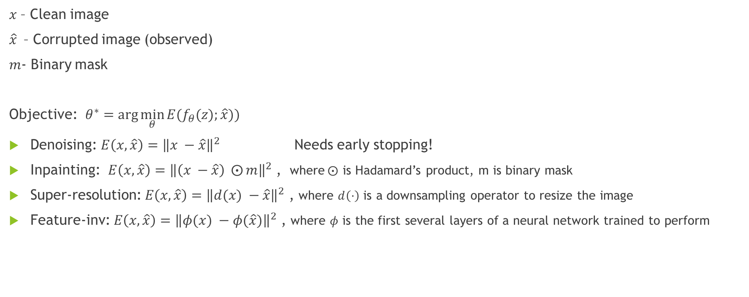
Data term
$x$– Clean image
$\hat{x}$ – Corrupted image (observed)
$m$- Binary mask
Objective: $θ^{∗}=arg{\min_{θ}{E(f_{θ}(z);\hat{x}))}}$
Denoising: $E\left(x,\hat{x}\right)={\left\|x −\hat{x}\right\|}^{2}$ Needs early stopping!
Inpainting: $E\left(x,\hat{x}\right)={\left\|\left(x −\hat{x}\right) ⨀{m}\right\|}^{2}$ , where$⨀$ is Hadamard’s product, m is binary mask
Super-resolution: $E\left(x,\hat{x}\right)={\left\|d(x) −\hat{x}\right\|}^{2}$ , where $d\left(·\right)$ is a downsampling operator to resize the image
Feature-inv: $E\left(x,\hat{x}\right)={\left\|φ(x) −φ(\hat{x})\right\|}^{2}$ , where $φ$ is the first several layers of a neural network trained to perform

Slide 12
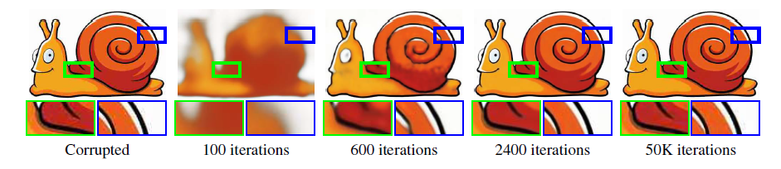
Experiments
Denoising and generic reconstruction
Deep Image Prior approach can restore an image with a complex degradation (JPEG compression in this case). As the optimization process progresses, the deep image prior allows to recover most of the signal while getting rid of halos and blockiness (after 2400 iterations) before eventually overfitting to the input (at 50K iterations).

Slide 13
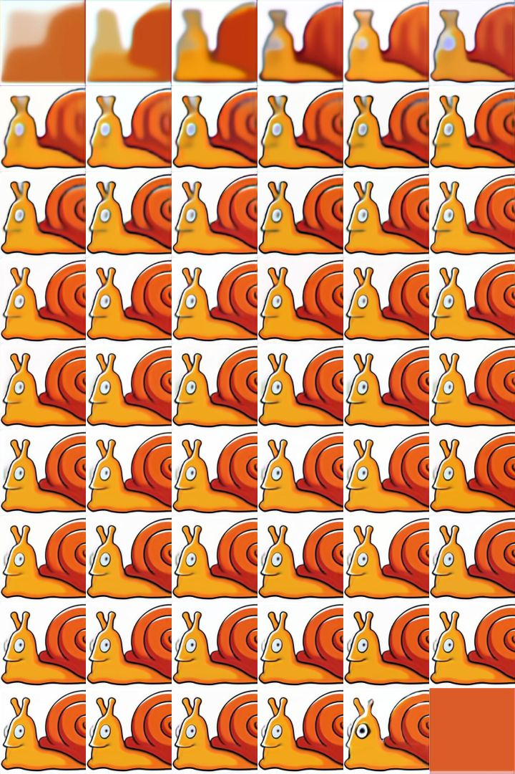

Slide 14
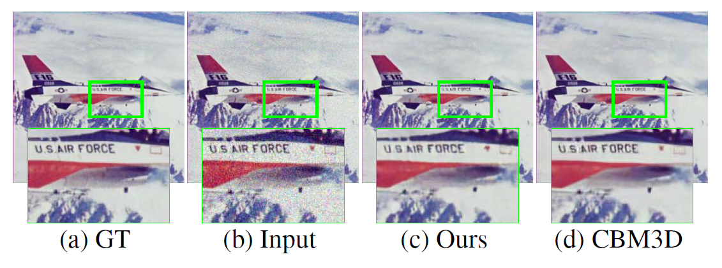
The deep image prior is successful at recovering both man-made and natural patterns.

Slide 15
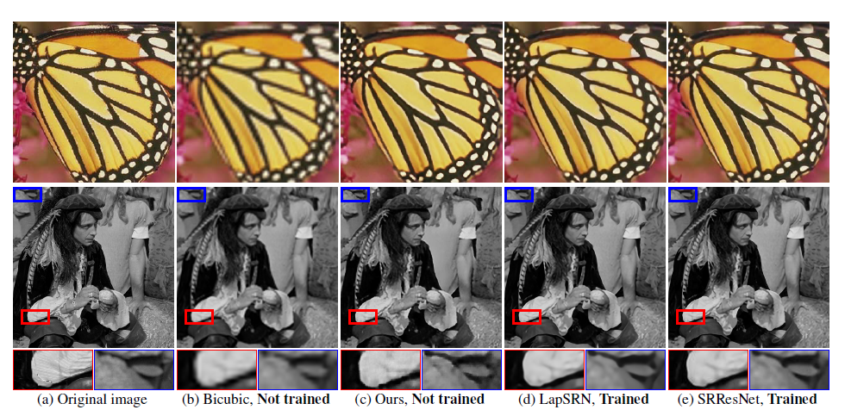
Super-resolution
use a scaling factor of 4 to compare to other works
fix the number of optimization steps to be 2000 for every image

Slide 16
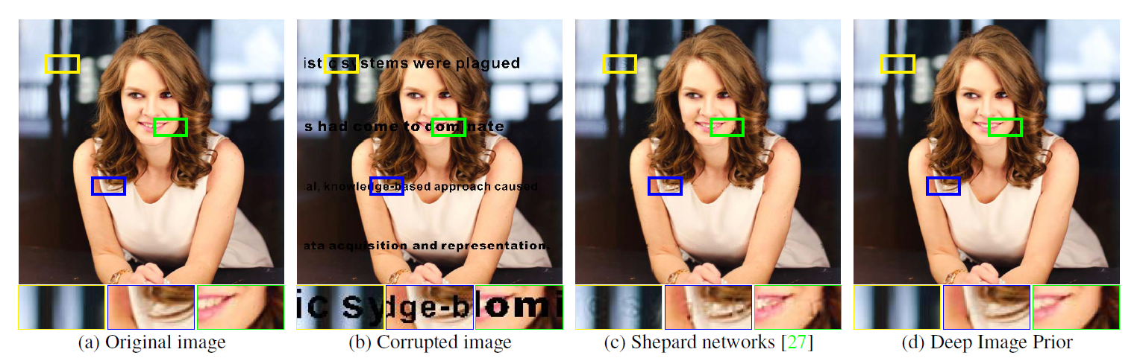
Inpainting
Text inpainting

Slide 17
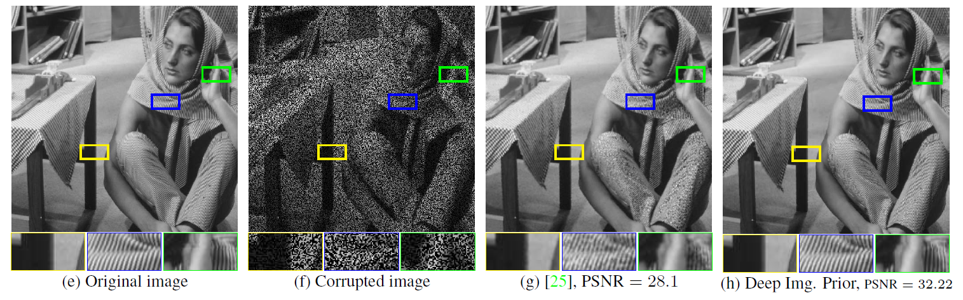
Image restoration
sampled to drop 50% of pixels at random
g is the result from comparison with Shepard networks

Slide 18
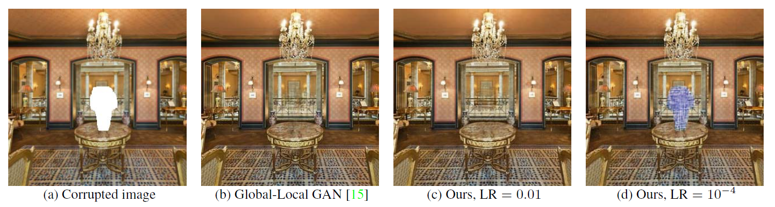
Inpainting of large holes
The deep image prior utilizes context of the image and interpolates the unknown region with textures from the known part. Such behaviour highlights the relation between the deep image prior and traditional self-similarity priors

Slide 19
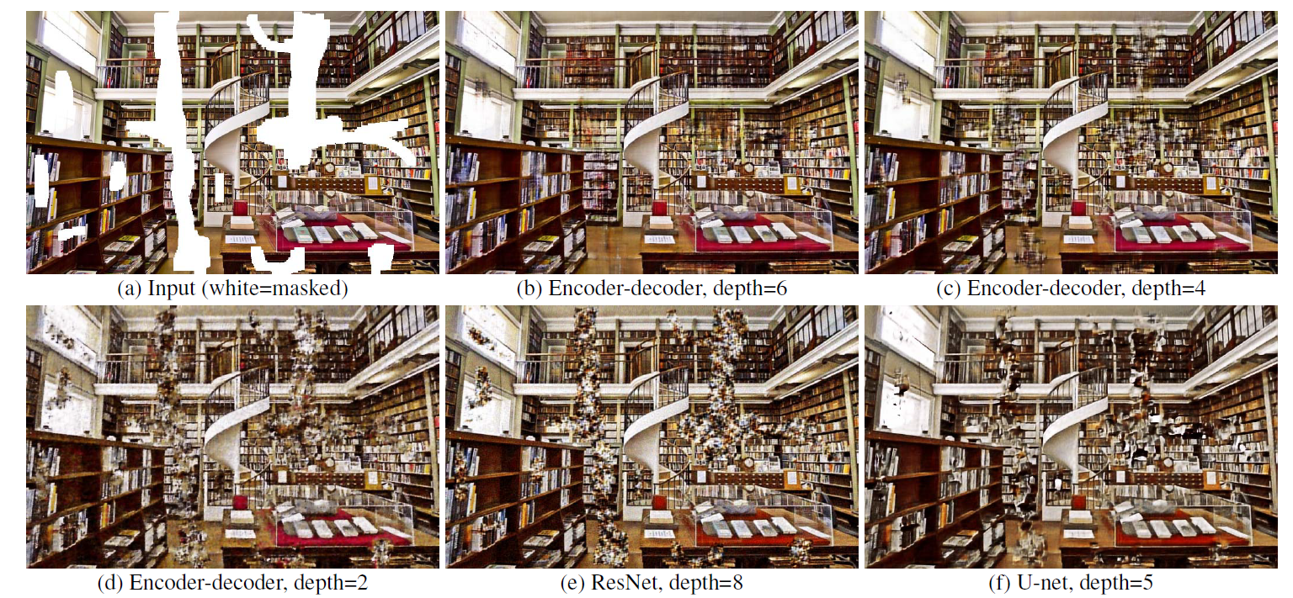
Inpainting of large holes
Inpainting using different depths and architectures.
The figure shows that much better inpainting results can be obtained by using deeper random networks. However, adding skip connections to ResNet in U-Net is highly detrimental.

Slide 20
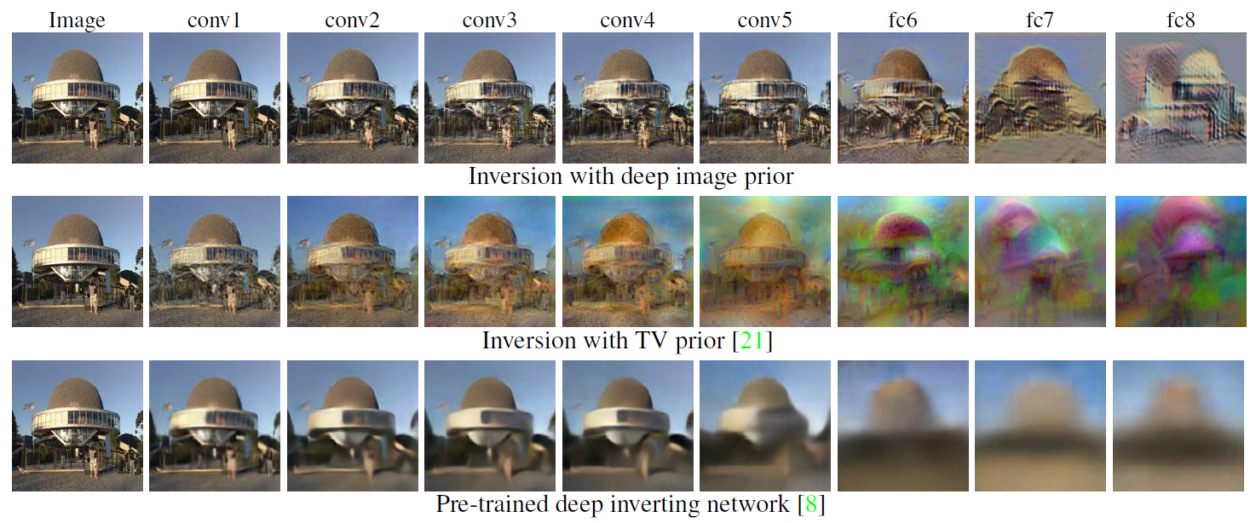
Feature-inversion (AlexNet Inversion)
Given the image on the left, it shows the natural pre-image obtained by inverting different layers of AlexNet using three different regularizers.
The deep image prior results in inversions at least as interpretable as the ones of [8].

Slide 21
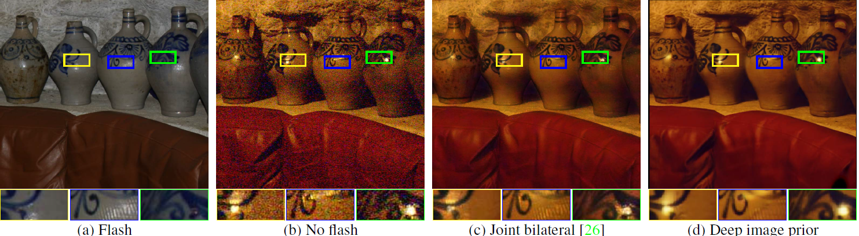
Flash/No Flash
The proposed approach can be extended to the tasks of the restoration of multiple images
The flash-no flash image pair-based restoration is to obtain an image of a scene with the lighting similar to a no-flash image, while using the flash image as a guide to reduce the noise level.
The deep image prior allows to obtain low-noise reconstruction with the lighting very close to the no-flash image.

Slide 22
Thank you !

